Slide 1
CCTS Annual Report
2019
Editorial Office ccts@amegroups.com

Slide 2
Outline of the Report
Basic Information
International Distribution of Editorial Board Members
Articles Published (2019)
Website Pageviews (2019)
Website Users (2019)
Focused Issues
ESTS 2019: Meet the Experts
The First International Lung Surgery Competition (2019 Masters of Lung Surgery)

Slide 3
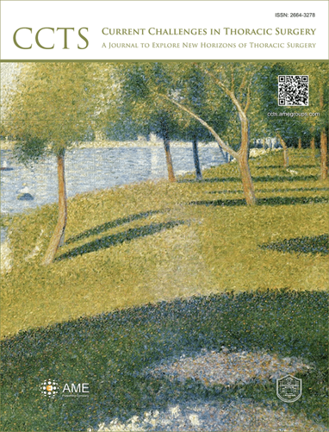
1. Basic Information
Current Challenges in Thoracic Surgery
(CCTS, Curr Chall Thorac Surg, ISSN: 2664-3278)
Launched in March 2019
An open access, peer- reviewed online journal
The Official Publication of the Department of Thoracic Surgery, Shanghai Pulmonary Hospital
Focus on current challenges, controversial issues and unresolved situations of thoracic surgery
Encourage innovations also from related specialties such as pulmonary medicine, transplantation, anesthesiology, pathology, imaging, biology, critical care medicine, and nursing.
Try to present similarities and differences in how different parts of the world manage these problems.

Slide 4
1. Basic Information

Slide 5
“We would like to express our heartfelt appreciation to all the editorial board members, guest editors, authors, reviewers and readers for your precious support and contributions to the journal at its initial challenging period of establishment in 2019. We would look forward to your joint efforts on the platform of CCTS to expand the boundaries in thoracic surgery and improve the quality and safety of surgery for patients, and encourage innovations.”
Gening Jiang, MD
Co-Editor-in-Chief,
Current Challenges in Thoracic Surgery
Douglas J. Mathisen, MD
Co-Editor-in-Chief,
Current Challenges in Thoracic Surgery

Slide 6
2. International Distribution of Editorial Board Members
Total: 86 members from 13 countries
Editors-in-Chief: 2
Associate Editors-in-Chief: 2
Associate Editor: 1
Editorial Board Members: 81
% of total: 100% (86 Editorial Board Members from 13 countries)
Country | Number
USA | 43
Japan | 9
Italy | 6
China | 4
UK | 6
Spain | 4
Canada | 4
Turkey | 2
Brazil | 2
Switzerland | 2
Germany | 2
France | 1
Argentina | 1

Slide 7
3. Articles Published (2019) - The Proportion of Different Article Types
% of total: 100% (26 manuscripts)
Totally 26 manuscripts have been published since the launch of journal in March 2019.
Article Type | Number
Case Report | 16
Review Article | 4
Original Article | 2
Surgical Technique | 1
Clinical Guideline | 1
News | 1
Foreword | 1

Slide 8
3. Articles Published (2019) - Numbers of Corresponding Authors Classified by Countries (2019)
Totally 26 corresponding authors.

Slide 9
4. Website Pageviews (Results by Month in 2019)
Dec 2019
Pageviews: 2866
Total number of pageviews reached 18,847 in 2019.
Data collected from Google Analytics on Jan 6, 2020.

Slide 10
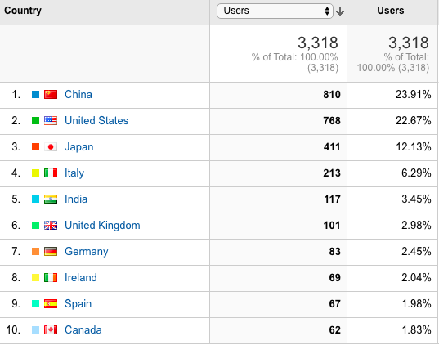
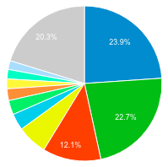
5. Website Users (2019)
The number of users in 2019 reached 3318. Users from China ranks the first, followed by users from USA, Japan, Italy, etc.
Data collected from Google Analytics on Jan 6, 2020.

Slide 11
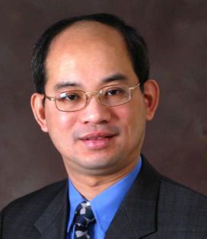
6. Focused Issues (ongoing)
1) Surgical Management of Chest Wall Tumors
Guest Editors
Francesco Puma, MD
Department of Thoracic Surgery, University of Perugia School of Medicine, Perugia, Italy
Hon Chi Suen, MBBS, FACS
Cardio-thoracic Surgery Centre, Hong Kong Sanatorium and Hospital, Hong Kong, China

Slide 12
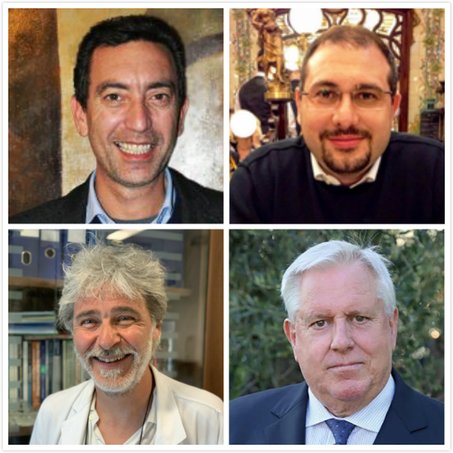
6. Focused Issues (ongoing)
2) Thoracic Surgery Without Borders
Guest Editors
Francesco Zaraca, MD, PhD
Division of Vascular and Thoracic Surgery,
Hospital of Bolzano, Bolzano, Italy
Luca Bertolaccini, MD, PhD, FCCP
Division of Thoracic Surgery,
IEO European Institute of Oncology IRCCS, Milan, Italy
Reinhold Perkmann, MD
Division of Vascular and Thoracic Surgery,
Hospital of Bolzano, Bolzano, Italy
Roberto Crisci, MD
Full Professor of Thoracic Surgery,
Division of Thoracic Surgery, Thoracic Surgery Unit,
University of L’Aquila, “G. Mazzini” Hospital, Teramo, Italy

Slide 13
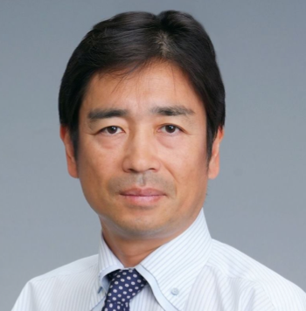
6. Focused Issues (ongoing)
3) Empyema
Guest Editor
Satoshi Shiono, MD
Department of Thoracic Surgery, Yamagata Prefectural Central Hospital, Yamagata, Japan

Slide 14
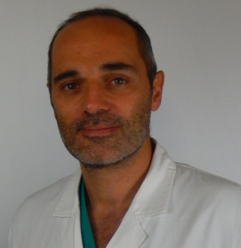
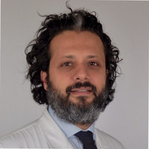
6. Focused Issues (ongoing)
4) The treatment of locally advanced lung cancer
Guest Editors
Davide Tosi, MD
Thoracic Surgery and Lung Transplantation Unit, Fondazione I.R.C.C.S. Ca’ Granda Ospedale Maggiore Policlinico, Milan, Italy
Alessandro Palleschi, MD
Thoracic Surgery and Lung Transplantation Unit, Fondazione I.R.C.C.S. Ca’ Granda Ospedale Maggiore Policlinico, Milan, Italy

Slide 15
6. Focused Issues (ongoing)
5) Lung Transplantation
Guest Editor:
Antonio Alvarez, MD, PhD
Department of Thoracic Surgery and Lung Transplantation, University Hospital Reina Sofía, Cordoba, Spain

Slide 16
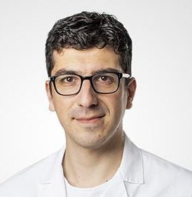
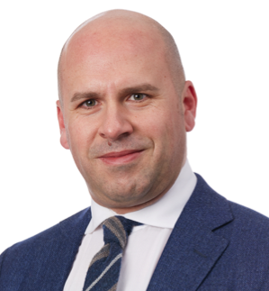
6. Focused Issues (ongoing)
6) Controversies in the Management of Stage IIIA Non-Small-Cell Lung Cancer
Guest Editors
Fabrizio Minervini, MD, PhD
Division of Thoracic Surgery, Cantonal Hospital of Lucerne, Luzern, Switzerland
Marco Scarci, MD
Department of Thoracic Surgery, San Gerardo Hospital, Monza, Italy

Slide 17
6. Focused Issues (upcoming)
Topic | Guest Editor | Affiliation
How to evaluate, diagnose and treat small lung nodules | Scott Swanson, MD | Division of Thoracic Surgery, Brigham and Women's Hospital, Harvard Medical School, Boston, USA
 | Daniel Dolan, MD | Division of Thoracic Surgery, Brigham and Women's Hospital, Harvard Medical School, Boston, USA
Anesthesia and Pain Control/ERAS (Enhanced Recovery After Surgery) | George Rakovich, MD | Division of Thoracic Surgery, Department of Surgery, Hôpital Maisonneuve-Rosemont, University of Montreal, Montréal, Québec, Canada
 | Jean Bussières, MD | Department of Anesthesiology and Critical Care, Université Laval, Quebec City, QC, Canada.

Slide 18
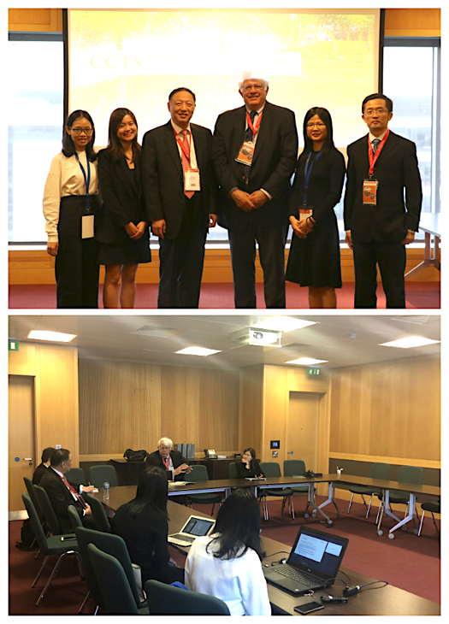
7. ESTS 2019: Meet the Experts
The 27th European Conference on General Thoracic Surgery was held on 9 – 12 June 2019, Dublin, Ireland. It was a great honor for the editorial team to meet the experts and promote the journal CCTS there.
Significantly, the Editors-in-Chief Dr. Genign Jiang and Dr. Douglas Mathisen as well as the editorial staff had a meeting during the ESTS meeting in Dublin to discuss on the focus, strategy and plan for the journal.

Slide 19
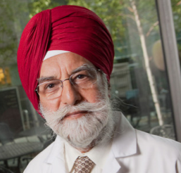
7. ESTS 2019: Meet the Experts
The editorial staff also conducted brief interviews with some of the thoracic experts during the meeting. The interviews can be views at:
http://ccts.amegroups.com/post/category/meet-the-professor
Interview with the Experts: Drs Walter Klepetko, Manjit Bains, Matthew Bott, David Healy, Marco Scarci

Slide 20
8. The First International Lung Surgery Competition (2019 Masters of Lung Surgery)
The First International Lung Surgery Competition is jointly hosted by AME Publishing Company and Shanghai Pulmonary Hospital.
All lung surgeons are eligible to participate in this competition, and the competition includes all of the operations in the field of lung surgery.
The winners of the event will have priority access for publishing their surgical video articles in CCTS, be invited to attend the award ceremony that will be held at the Shanghai Pulmonary Hospital Conference in 2020, and have an opportunity for a one-week study tour of the Shanghai Pulmonary Hospital.

Slide 21
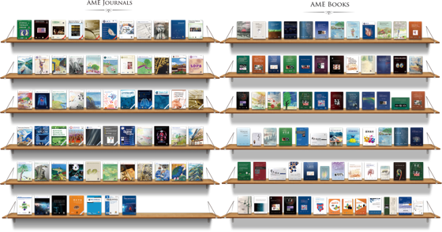
AME Publishing Company
Our Publisher–
AME Publishing Company
www.amegroups.com
Established in 2009
Registered in Hong Kong
10 offices around the world
60+ peer-reviewed journals
13 indexed in SCIE
18 indexed in PubMed/PMC/MEDLINE
120+ Medical Books
(60+ in English & 60+ in Chinese)
120+ electronic editions

Slide 22
Thank you for all your support!

